Slide 1


Tanjima Nasreen Jenia 16.10.2021

Slide 2

Outline
Executive Summary
Introduction
Methodology
Results
Conclusion
Appendix

Slide 3
Executive Summary
Summary of methodologies
In this project, the Falcon9 Launch data was collected via SpaceX API and Falcon 9 launch wiki page by web scraping using BeautifulSoup, and later on stored in a csv for indepth analysis. Before performing any exploratory and visual analysis, the data was cleaned by getting rid of unwanted features, replacing the missing values, creating a label for the predictive analysis and finally, converting all the categorical features into numerical forms. After that, performed several visual analytics to get more insights about features and their relation with launching outcome. To answer our question, “whether a landing would be successful or not”, a predictive analysis was performed on several models and finally, chose a model that outperformed all.
Summary of all results
Exploratory and Visual Analysis:
From 2010 to 2019, 61 missions had successful landing whereas 10 missions had failure landing, leading a success rate of 67.78%
Among the four Launch sites “KSC LC-39A” had the highest success rate (41.7%) whereas, “VAFB SLC-4E” had the lowest success rate (12.5%)

Slide 4
Executive Summary [Continued]
Exploratory and Visual Analysis:
Among 11 orbit types , ES-L1, GEO, HEO, SSO were 100% successful with less than 6000 kg payload
Payload greater than 7500 kg had a higher chance of successful landing
In 0-10000 kg payload range “FT” booster version has the largest success rate
Launch Site Proximity Analysis:
SpaceX has 4 launch sites, one is near California, the other three is near Florida and South Texas.
All the sites are in near proximity to ocean
All the sites are bit far away from the city
All the sites are nearer to the railroads than highways
Predictive Analysis:
Logistic Regression and Decision Tree performed well in comparison with other models, with the highest accuracy of 83.3%

Slide 5
Introduction
Introduction
Project background and context
SpaceX is a company that aims to make commercial space travel more affordable for everyone. By reusing the first stage of the rocket Falcon9 (the first orbital class rocket capable of re-flight), this company can launch rockets in a relatively high cost-efficient manner.
In this project, we are working for a company, Space Y, which is going to compete with SpaceX. Our goal is to find the cost of each launch. And this cost primarily depends on the successful landing of the first stage. Hence, we are presenting a classification analysis on whether the first stage would be successful or not.
Problems we want to find answers
Will SpaceX reuse the first stage?
Will SpaceX attempt to land a rocket or not? i.e., will the first stage land successfully?
5

Slide 6


Slide 7
Methodology
Executive Summary
Data collection methodology:
Data was collected via SpaceX API and web scraping using python “bs4” package.
Perform data wrangling
Data was processed via python “pandas”, “numpy” packages.
Perform exploratory data analysis (EDA) using visualization and SQL
Perform interactive visual analytics using Folium and Plotly Dash
Perform predictive analysis using classification models
Classification models were built, tuned, evaluated using python “sklearn”, “pandas”, and, “matplotlib” packages

Slide 8
Data Collection
Data sets were collected in two separate processes – using SpaceX API and web scraping SpaceX wiki page. Scraped datasets were later preprocessed and stored in separate CSV files.
Request rocket launch data to SpaceX URL using SpaceX-API
Parse the data from html text
Request More data using Launch IDs
Start
Construct “Pandas” DataFrames with Scraped Data
Request the Falcon9 Launch Wiki page using ‘requests’ module
Request rocket launch data
Parse the table from html text using “bs4”

Slide 9
Data Collection – SpaceX API
In this Process:
The data is collected by using SpaceX REST API
Perform a get request using the requests library to obtain the launch data
Use the SpaceX URL to target a specific endpoint of the API to get past launch data
GitHub URL of the completed SpaceX API calls notebook
SpaceX-API
Define Variables and Auxiliary Functions
Request launch data to SpaceX URL
Parse the data from html text
Request More data using Launch IDs
Preprocess and Construct the Data
Store the Data in CSV File

Slide 10
Data Collection - Scraping
In this Process:
Using requests module, get request from Falcon9 Launch Wiki page.
Using python’s BeautifulSoup package, web scrape HTML tables containing valuable Falcon 9 launch recording
Parse the data from the tables and convert them into a pandas data frame
GitHub URL of the completed web scraping notebook
Request the Falcon9 Launch Wiki page using ‘requests’ module
Request rocket launch data
Parse the table data from html text using bs4
Create a “pandas” data frame from table data
Construct the Data and Store it in CSV format

Slide 11
Data Wrangling
Filtered out the Falcon 1 launches data
Replaced the null values inside of PayLoadMass by its mean value
Created a Landing Outcome label from Outcome column
Converted all categorical columns to One Hot Encode
GitHub URL of completed data wrangling related notebook-1, notebook-2, notebook-3
Construct a “Pandas” DataFrame with Scraped Data
Dealing With Missing Values
One Hot Encoding to Categorical Columns
Filter the Dataframe to Only Falcon 9 launches
Create A Landing Outcome Label From Outcome Column
Cast All Numeric Columns to “float64”
Construct the Final DataFrame and dump in CSV file

Slide 12
EDA with Data Visualization
For Explorative Data Analysis, following charts were used:
CatPlot :
FlightNumber vs LaunchSite : To visualize the relationship between Flight Number and Launch Site
Payload vs Launch Site : To visualize the relationship between Payload and Launch Site
FlightNumber vs Orbit type : To visualize the relationship between Flight Number and Orbit type
Payload vs Orbit type : To visualize the relationship between Payload and Orbit type

Slide 13
EDA with Data Visualization [Continued]
Bar Chart
Orbit vs Success Rate : To visualize the relationship between success rate of each orbit type
Line chart
Year vs Class : To visualize the launch success yearly trend.
GitHub URL of the completed EDA with data visualization notebook

Slide 14
EDA with SQL
SQL queries performed :
To display the names of the unique launch sites in the space mission
To display 5 records where launch sites begin with the string 'CCA’
To display the total payload mass carried by boosters launched by NASA (CRS)
To display average payload mass carried by booster version “F9 v1.1”
To list the date when the first successful landing outcome in ground pad was achieved
To list the names of the boosters which have success in drone ship and have payload mass greater than 4000 but less than 6000

Slide 15
EDA with SQL [Continued]
SQL queries performed:
To list the total number of successful and failure mission outcomes
To list the names of the booster versions which have carried the maximum payload mass. Use a subquery
To list the failed landing outcomes in drone ship, their booster versions, and launch site names for in year 2015
To rank the count of landing outcomes (such as Failure (drone ship) or Success (ground pad)) between the date 2010-06-04 and 2017-03-20, in descending order
GitHub URL of the completed EDA with SQL notebook

Slide 16
Build an Interactive Map with Folium
Map objects which are created and added to the folium map are given below :
Markers : It marked a specific area with a text label on a specific coordinate
Circles : It highlighted circle area with a text label on a specific coordinate
MarkerCluster : Marker clusters are used to simplify the containing many markers having the same coordinates.
MousePosition : To get coordinate for a mouse over a point on the map. It helps to find the coordinates easily of any points of interests while exploring the map.
PolyLine : It draws polyline overlays on a map. It is used to denote the distance between a launch site and its proximities.
GitHub URL of the completed interactive map with Folium map

Slide 17
Build a Dashboard with Plotly Dash
Plots/graphs and interactions which are added to the dashboard -
Drop-down Input Component : To select different launch sites
Pie-chart : To visualize total success launches ratio by site
Range Slider : To select range of payload mass (kg)
Scatter Plot : To visualize the correlation between payload and success launch for all sites
GitHub URL of the completed Plotly Dash Notebook
GitHub URL of the completed Plotly Dash Lab Python file

Slide 18
Predictive Analysis (Classification)
The Following chart illustrates the whole predictive analysis workflow: from loading the data to selecting best model for classification. (Github Notebook URL)
Load the data
Create Model and GridSearchCV objects
Calculate Accuracy for Different Models
Features Standardization
Initiate Different GridSearachCV objects with models’ hyperparameters
Plot Confusion Matrix for Different Models
Split the Data Into 80:20 Ratio
Tune Models’ Hyperparameters
Select Best Performing Model

Slide 19
Results
Exploratory data analysis results
From 2010 to 2019, 61 missions had successful landing whereas 10 missions had failure landing, leading a success rate of 67.78%
Among the four Launch sites “KSC LC-39A” had the highest success rate (41.7%) whereas, “VAFB SLC-4E” had the lowest success rate (12.5%)
Payload greater than 7500 kg had a higher chance of successful landing
Among 11 orbit types , ES-L1, GEO, HEO, SSO were 100% successful with less than 6000 kg payload
In 0-10000 kg payload range “FT” booster version has the largest success rate.

Slide 20
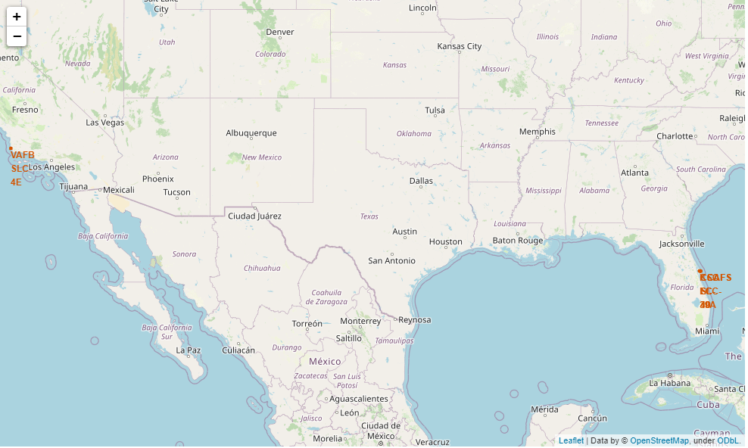
Results [Continued]
Interactive analytics via Folium Map

Slide 21
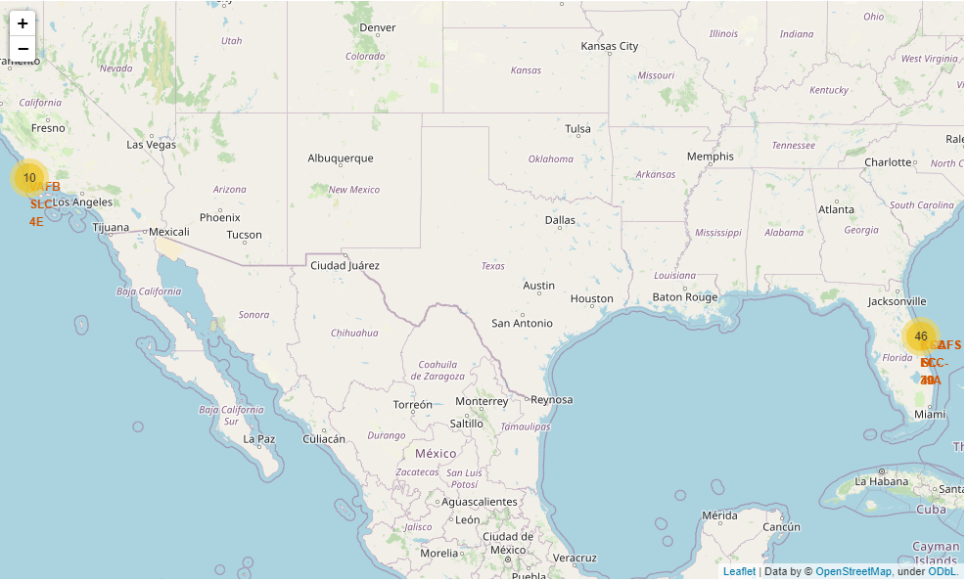
Results [Continued]
Interactive analytics via Folium Map

Slide 22
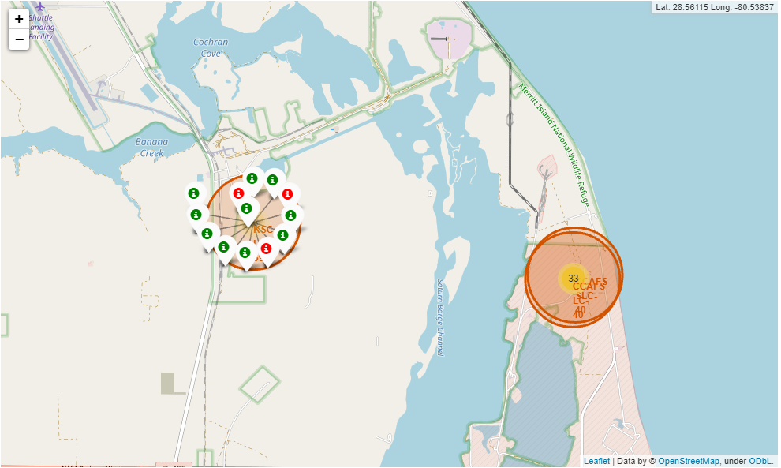
Results [Continued]
Interactive analytics via Folium Map

Slide 23
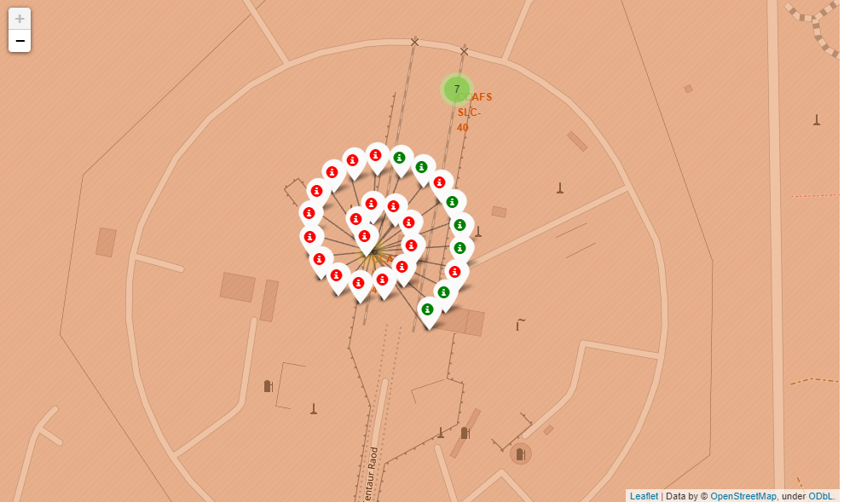
Results [Continued]
Interactive analytics via Folium Map

Slide 24
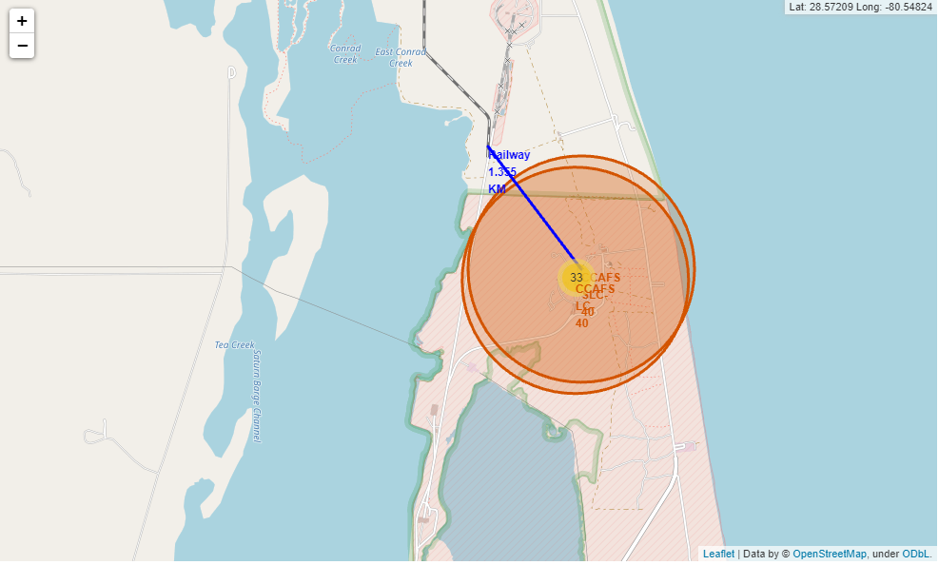
Results [Continued]
Interactive analytics via Folium Map

Slide 25
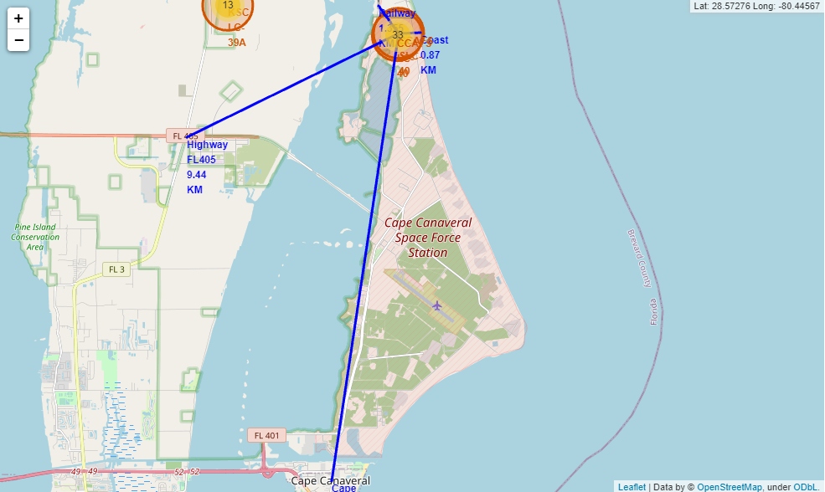
Results [Continued]
Interactive analytics via Folium Map

Slide 26
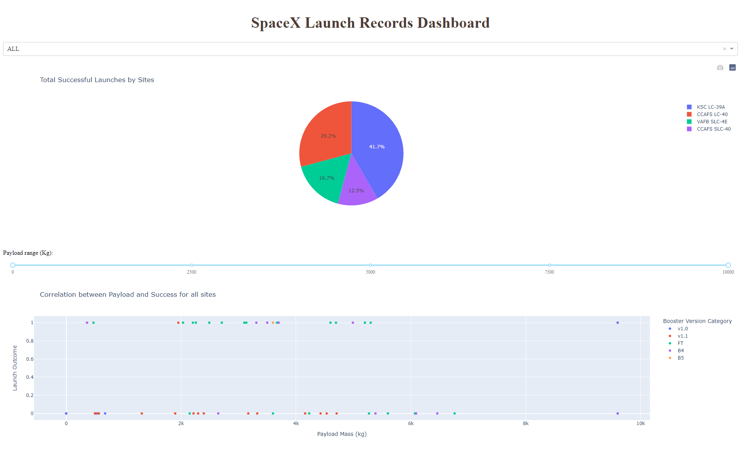
Results [Continued]
Interactive analytics Dashboard

Slide 27
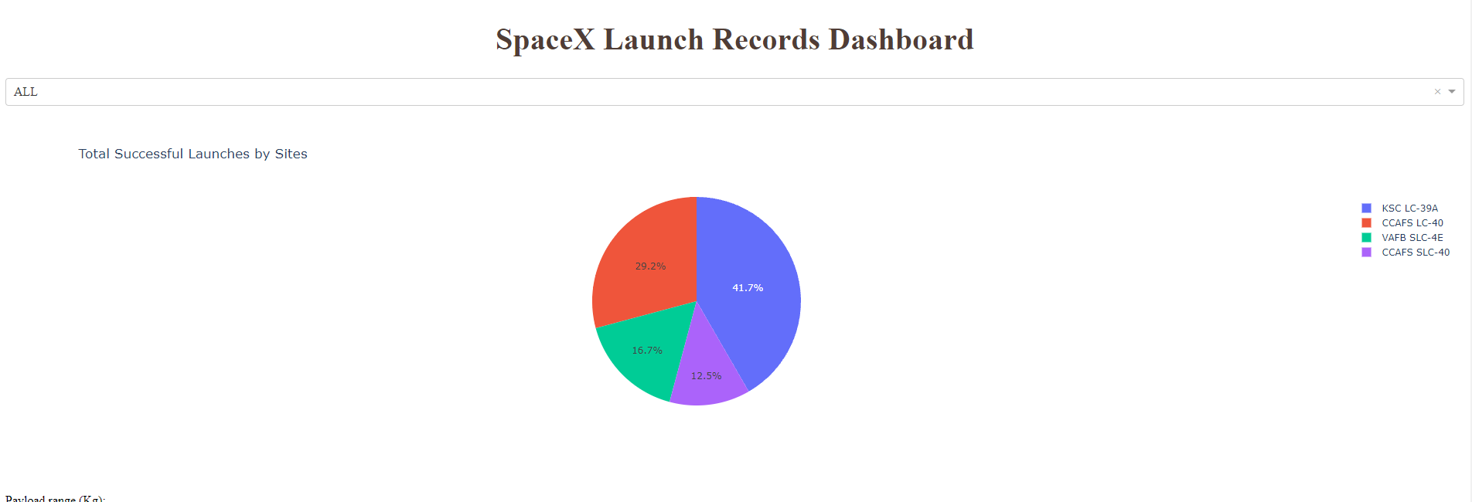
Results [Continued]
Interactive analytics Dashboard

Slide 28
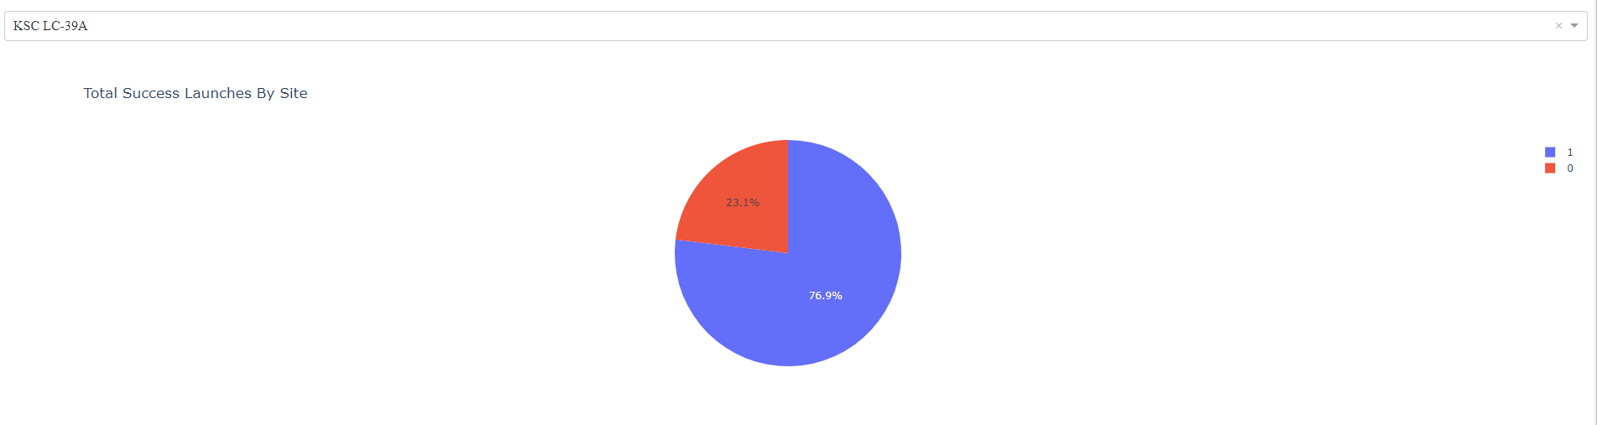
Results [Continued]
Interactive analytics Dashboard

Slide 29
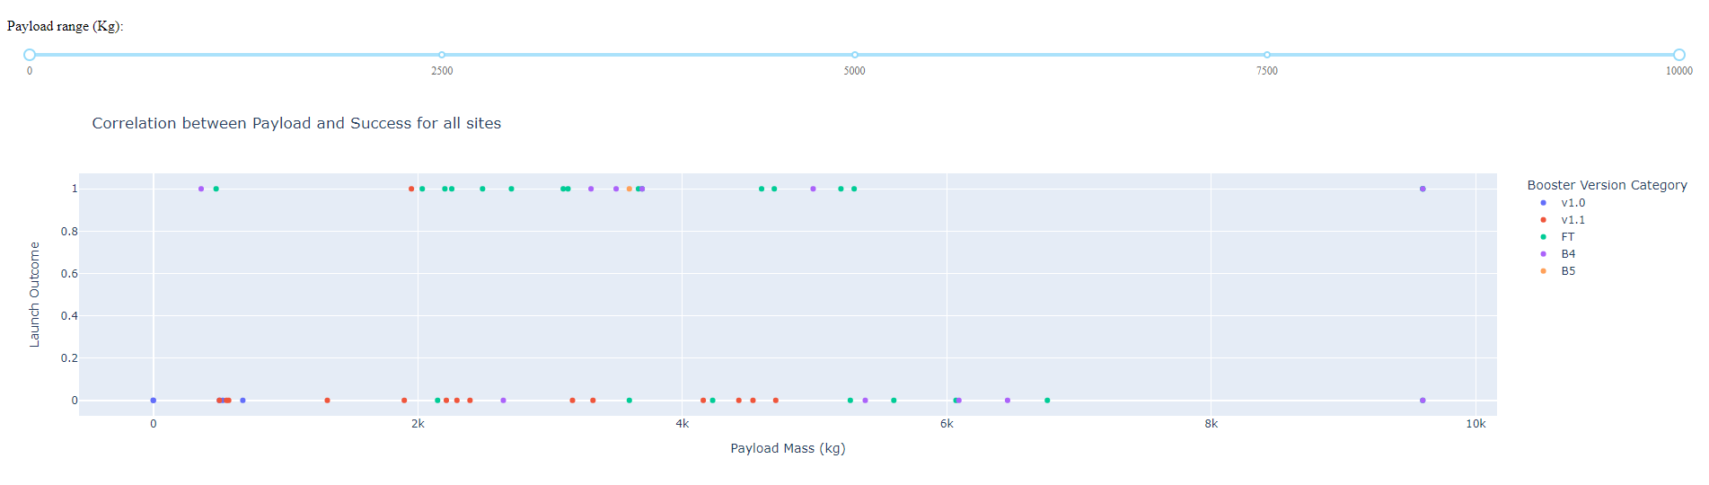
Results [Continued]
Interactive analytics Dashboard

Slide 30
Results
Predictive analysis results
Performed a predictive analysis on the dataset using Logistic Regression, SVM, Decision Tree and KNN Classifier
Logistic Regression and Decision Tree performed well in comparison with other models, with the highest accuracy of 83.3%

Slide 31


Slide 32
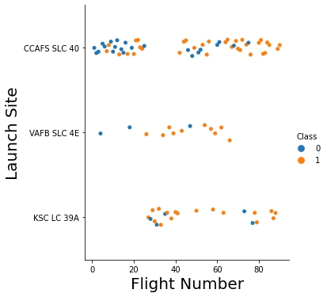
Flight Number vs. Launch Site
Success rate was gradually increasing for every launch site
After flight count reached 40, success rate increased dramatically

Slide 33
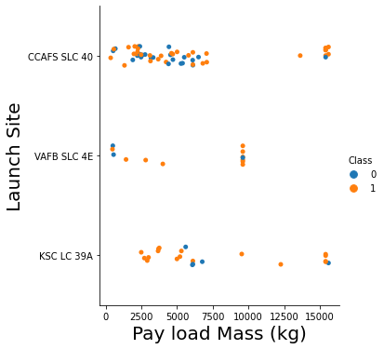
Payload vs. Launch Site
Payload greater than 7500 kg had a higher chance of successful landing (in all cases)
KSC LC 39A had the highest success rate among the 4 launch sites

Slide 34
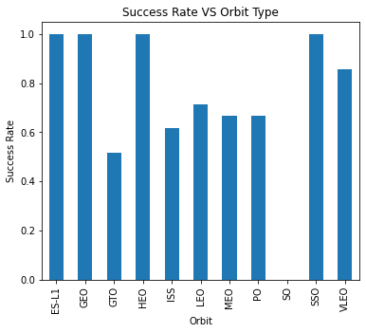
Success Rate vs. Orbit Type
“SO” orbit had no success
Among 11 orbit types , 4 types were 100% successful(ES-L1, GEO, HEO, SSO)
“GTO” had approximately 50% success rate whereas the rest of the orbit types had more than 50% success rate

Slide 35
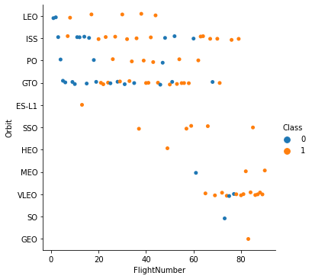
Flight Number vs. Orbit Type
LEO , ISS, PO ,GTO had more flight counts than other orbit types
SO,GEO,HEO orbit type had only 1 flight which was a failure, success and success respectively
ES-L1, SSO, GEO, HEO had 100% success landing in terms of flights.

Slide 36
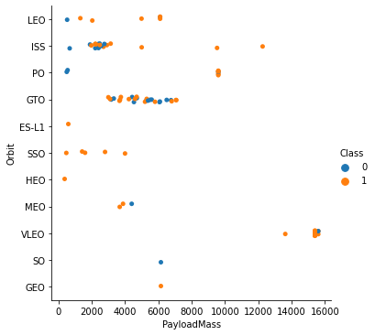
Payload vs. Orbit Type
Only ISS, PO and VLEO orbits carried more than 8000 kg payload.
ES-L1, SSO, HEO,GEO had less than 6000 kg payload in their orbit with 100% success

Slide 37
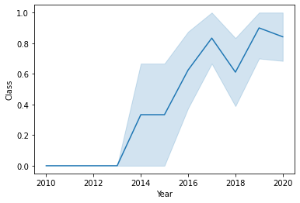
Launch Success Yearly Trend
Before 2013, there was no success
After 2013 success rate increased dramatically
Launch success peaked in 2019

Slide 38
All Launch Site Names
There are total of 4 launch sites, the list is given below -
Launch Site
CCAFS LC-40
CCAFS SLC-40
KSC LC-39A
VAFB SLC-4E

Slide 39
Launch Site Names Begin with 'CCA'
The below list represents 5 records where launch sites begin with `CCA`, all of them refers to the same launch site
Launch Site
CCAFS LC-40
CCAFS LC-40
CCAFS LC-40
CCAFS LC-40
CCAFS LC-40

Slide 40
Total Payload Mass
Total payload carried by boosters from NASA (CRS)
Total Payload Mass
48213

Slide 41
Average Payload Mass by F9 v1.1
The average payload mass carried by booster version F9 v1.1. It is approximately 2500 kg.
Avg Payload Mass (F9 v1.1)
2534.666666

Slide 42
First Successful Ground Landing Date
The date of the first successful landing outcome on ground pad. It is at the end of 2015.
Date
2015-12-22

Slide 43
Successful Drone Ship Landing with Payload between 4000 and 6000
The below list represents the names of boosters which have successfully landed on drone ship and had payload mass greater than 4000 but less than 6000
Booster Version
F9 B5 B1046.2
F9 B5 B1047.2
F9 B5 B1046.3
F9 B5 B1048.3
F9 B5 B1051.2
F9 B5B1060.1
F9 B5 B1058.2
F9 B5B1062.1

Slide 44
Total Number of Successful and Failure Mission Outcomes
The total number of successful and failure mission outcome. The successful outcomes is 6 times of the failure outcomes.
Successful outcomes | Failure outcomes
61 | 10

Slide 45
Boosters Carried Maximum Payload
The below list represents the names of the booster which have carried the maximum payload mass. There are total of 12 them.
Booster Version
F9 B5 B1048.4 | F9 B5 B1049.5
F9 B5 B1049.4 | F9 B5 B1060.2
F9 B5 B1051.3 | F9 B5 B1058.3
F9 B5 B1056.4 | F9 B5 B1051.6
F9 B5 B1048.5 | F9 B5 B1060.3
F9 B5 B1051.4 | F9 B5 B1049.7

Slide 46
2015 Launch Records
The below list represents the failed landing outcomes in drone ship, their booster versions, and launch site names for in year 2015. It happened in the same launch site.
Landing_Outcome | Booster_Version | Launch_Site
Failure (drone ship) | F9 v1.1 B1012 | CCAFS LC-40
Failure (drone ship) | F9 v1.1 B1015 | CCAFS LC-40

Slide 47
Rank Landing Outcomes Between 2010-06-04 and 2017-03-20
The below list represents the ranking of the count of landing outcomes (such as Failure (drone ship) or Success (ground pad)) between the date 2010-06-04 and 2017-03-20, in descending order.
Landing Outcome | Count
No attempt | 10
Failure (drone ship) | 5
Success (drone ship) | 5
Controlled (ocean) | 3
Success (ground pad) | 3
Failure (parachute) | 2
Uncontrolled (ocean) | 2
Precluded (drone ship) | 1

Slide 48


Slide 49
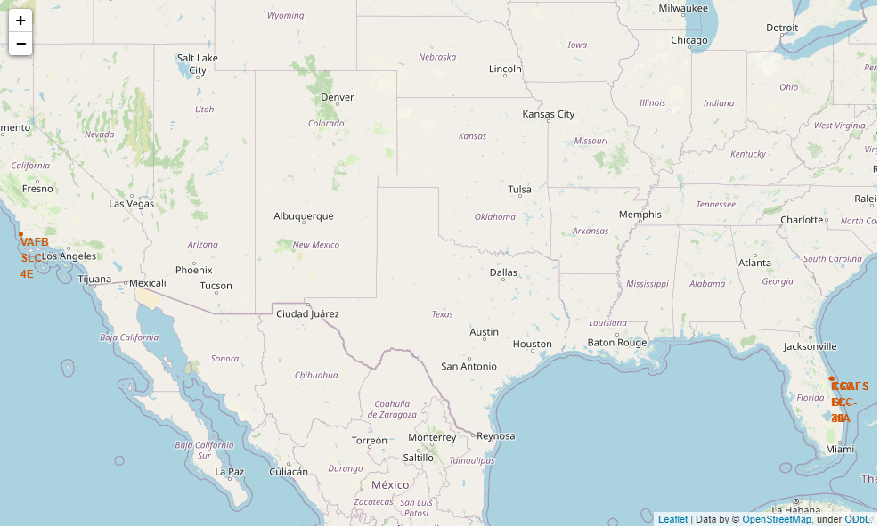
All Launch Sites Of SpaceX On The Map
SpaceX has 4 launch facilities, one is near California, the other three is near Florida and South Texas. All facilities are near the ocean.

Slide 50
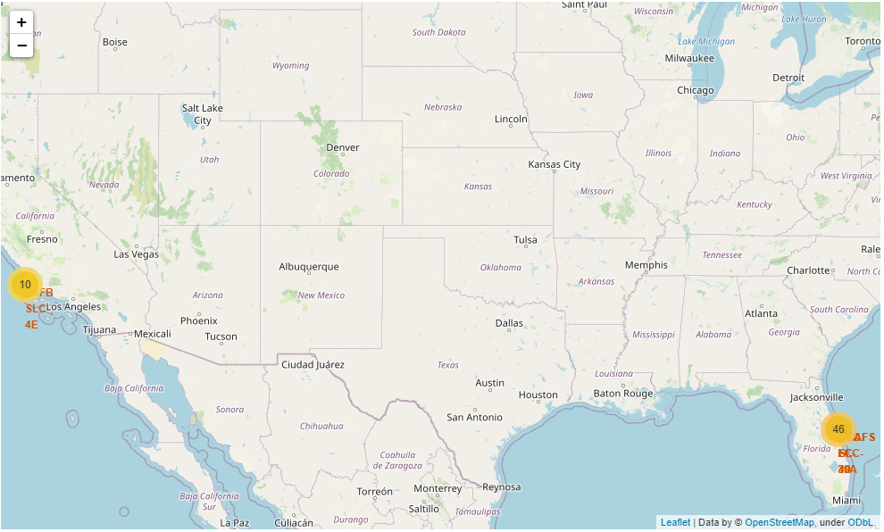
Success/Failed Launches For Each Site On The Map
Marker clusters is used to simplify the map containing many markers having the same coordinate (check 3 locations near Florida). Successful launches are marked using a green marker and failed launches are marked using a red marker.

Slide 51

Distance Between A Launch Site To Its Proximities
A blue distance line denotes the distance between a launch site ( CCAFS SLC-40 ) to its near proximities (Coast line, Railroad, Highway and City)

Slide 52


Slide 53
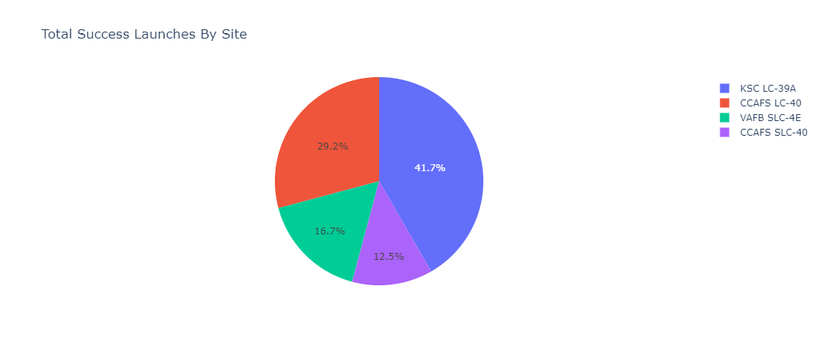
Total Success Launches By Site
Below is the screenshot of launch success count for all sites, in a pie-chart
“KSC LC-39A” has the highest success ratio whereas “VAFB SLC-4E” had the lowest success ratio among all four launch sites.

Slide 54
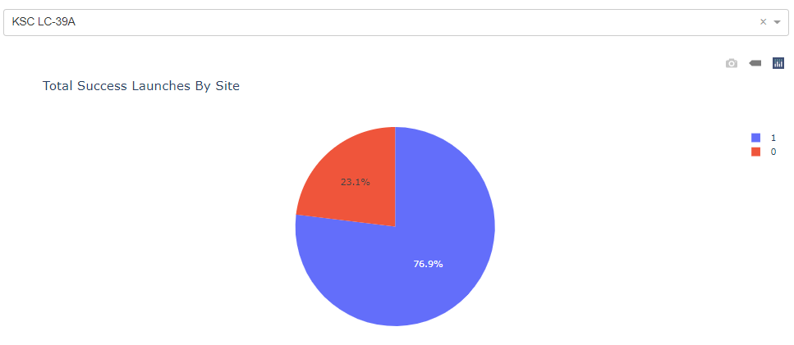
Launch Site With Highest Launch Success Ratio
Below is the screenshot of the pie-chart for the launch site with the highest launch success ratio – “KSC LC-39A”
It has 77% of success ratio.

Slide 55
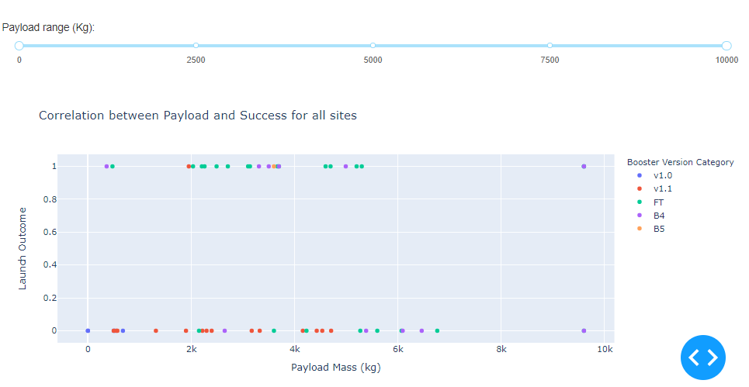
Payload vs. Launch Outcome
Below are the screenshot of Payload vs. Launch Outcome scatter plot for all sites, with different payload selected in the range slider
In 0-10000 kg payload range “FT” booster version has the largest success rate.

Slide 56
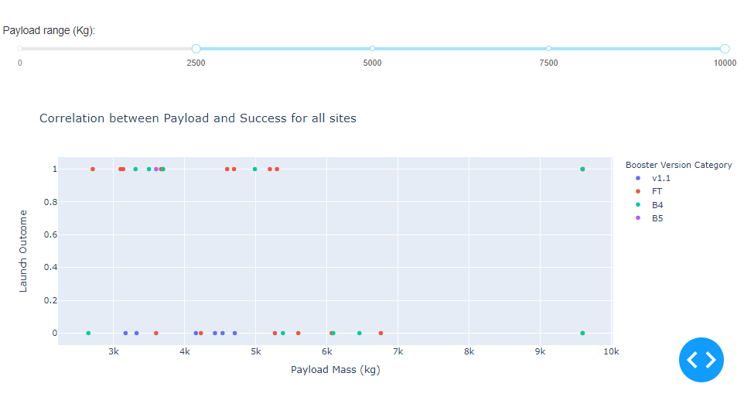
Payload vs. Launch Outcome [Continued]
Payload vs. Launch Outcome between 2500 kg and 10000 kg.
In this range “FT” booster version has the largest success rate.

Slide 57
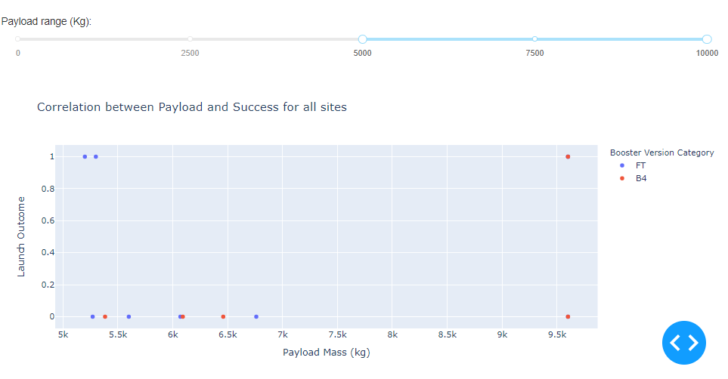
Payload vs. Launch Outcome [Continued]
Payload vs. Launch Outcome between 5000 kg and 10000 kg.
In this range “FT” booster version has the largest success rate whereas “B4” booster version has no success.

Slide 58

Payload vs. Launch Outcome [Continued]
Payload vs. Launch Outcome between 7500 kg and 10000 kg.
In this range only “B4” booster version is used and has equal success / failure rate.

Slide 59


Slide 60
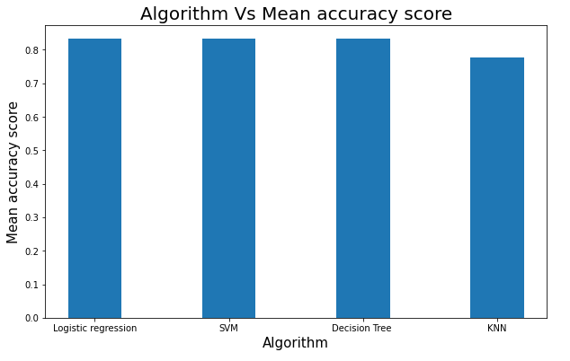
Classification Accuracy
Logistic Regression and Decision Tree has the highest accuracy which is approximately 0.83
KNN Classifier has the lowest accuracy (0.78) among all four models

Slide 61
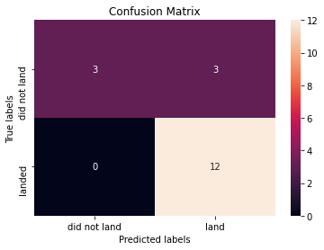
Confusion Matrix
Here is the confusion matrix of the best performing model (Logistic Regression and Decision Tree– both generates the same result).
It has True Positive value of 12 and False Negative of 0. It means this model correctly identified 12 instances which actually belong to class 1(successful landing), conversely it predicted correctly only 50% (3 out of 6) of the class 0 (landing failure).

Slide 62
Conclusions
Here on this project we explored the SpaceX data and built a classifier on whether a rocket launch outcome (landing) would be successful or not
For a more robust analysis, this dataset is not adequate. More data is needed.
Different types of algorithms should be explored to generate a better and robust classifier (Gradient boosting, Neural Network etc.)
An end-to-end pipeline should be built for classification model that automates most of its process.

Slide 63
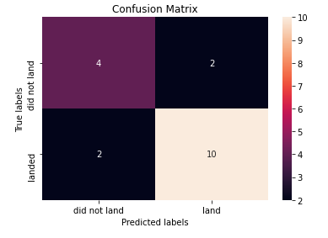
Appendix
Here, is the confusion matrix of KNN Classifier, which gave the lowest accuracy.
It has True Positive value of 10 and False Negative of 2. It means this model correctly identified 10 instances which actually belong to class 1(successful landing), conversely it predicted correctly 66% (4 out of 6) of the class 0 (landing failure).
Although, its accuracy is lower than the other ones, its Specificity (True Negative Rate) is 66.67%, which is higher than the other models.

Slide 64


